Slide 1
Python numpy
By JJ

Slide 2
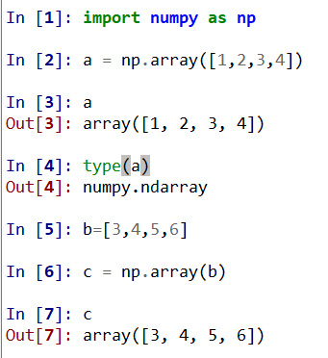
Numpy (numeric Python): array

Slide 3
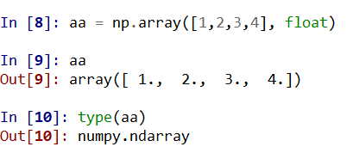
Numpy array (cont.)

Slide 4
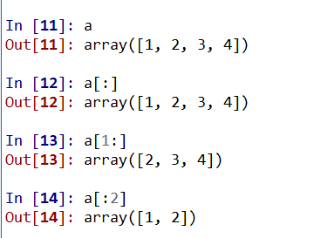
Numpy array slicing (like Python)

Slide 5
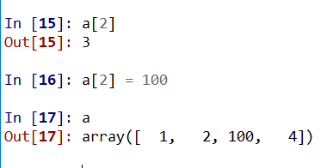
Access and mutate

Slide 6
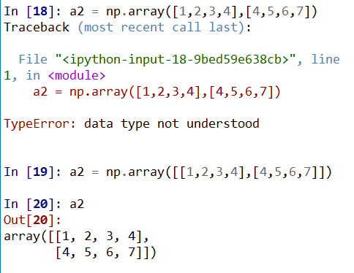
N dimensional array (here N = 2)

Slide 7
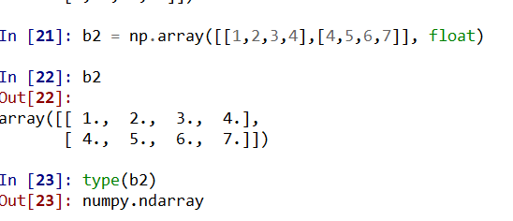
Specify dtype

Slide 8
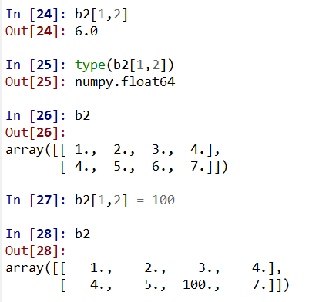
2 d array Access and mutate

Slide 9
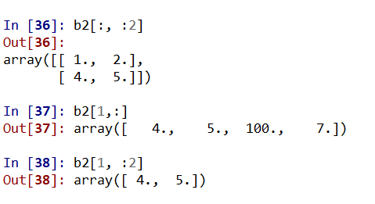
2 d array slicing

Slide 10
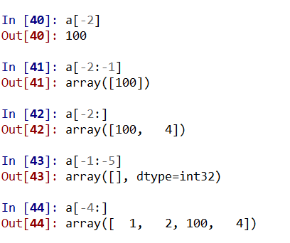
Note negative index still working

Slide 11
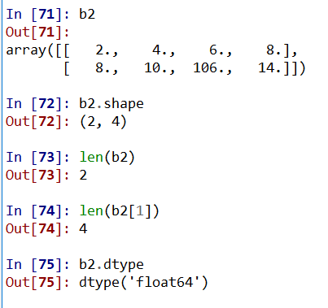
Properties shape, dtype

Slide 12
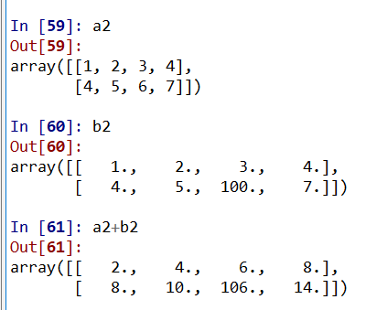
Element-wise operation (addition)

Slide 13
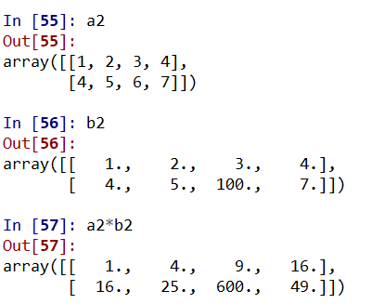
Element-wise operation (multiplication)

Slide 14
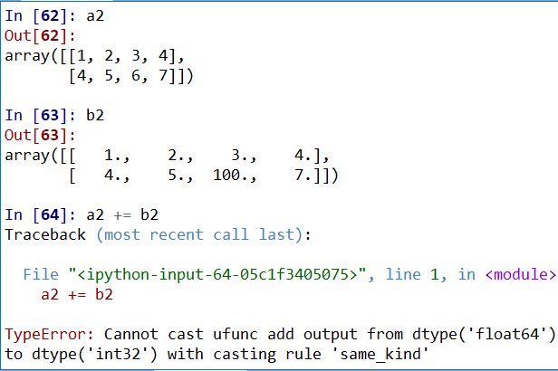
Compound assignment (beware casting error)

Slide 15
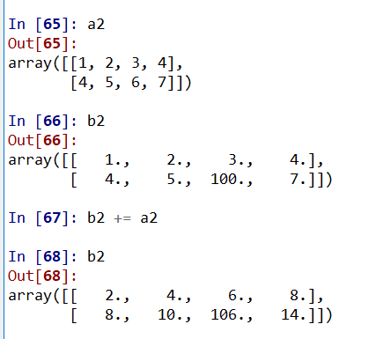
Use += (also -=, *=, and /=) cast from int to float is okay

Slide 16
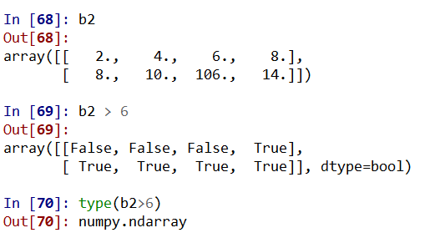
Logical operation

Slide 17
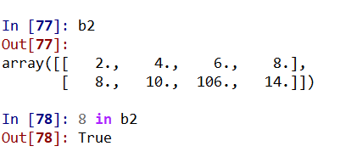
Membership using in

Slide 18
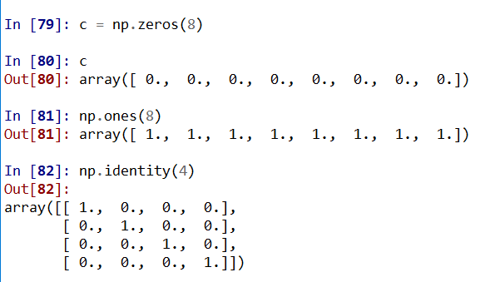
Quick way to create arrays: ones and zeros

Slide 19
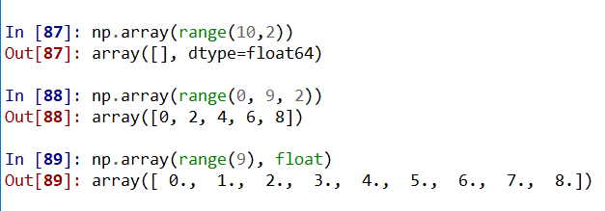
Quick way to create arrays :use range() (cont.)

Slide 20
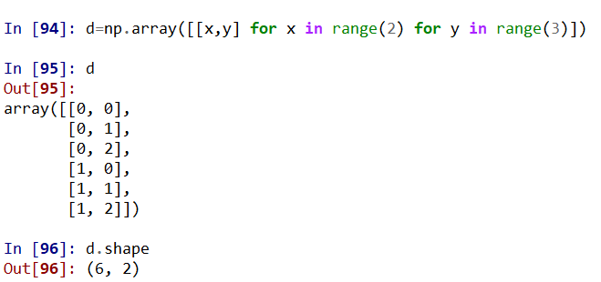
Quick way to create arrays (cont.) using list

Slide 21
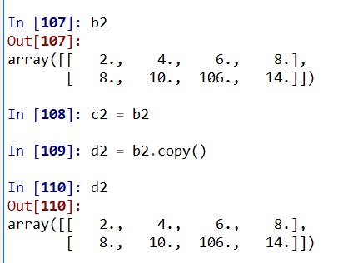
Quick way to create arrays (cont.)
Use python copy

Slide 22
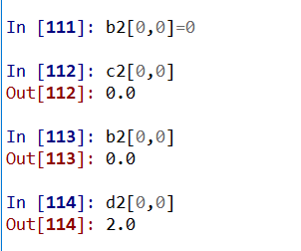
Note the namespace biding
Note d2 is a new one, no side effect from b2

Slide 23
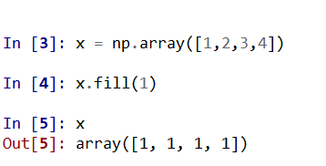
Fill an array with a single value

Slide 24
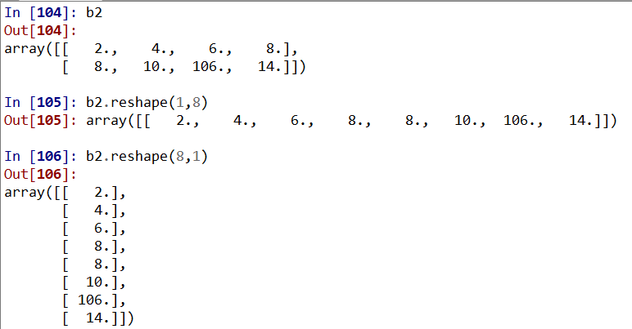
Change dimension using reshape
Arrays can be reshaped using tuples that specify new dimensions

Slide 25
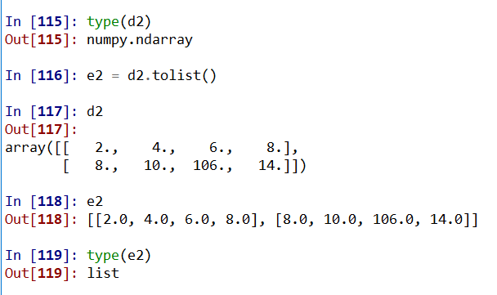
Convert numpy array to Python list: use tolist()

Slide 26
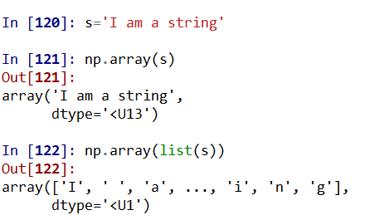
From string to list then numpy array

Slide 27
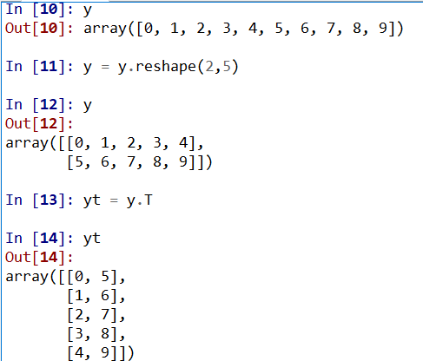
Reshape and Transpose(use y.T

Slide 28
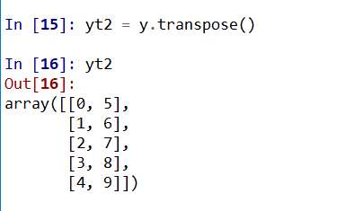
OR use transpose() method to transpose

Slide 29
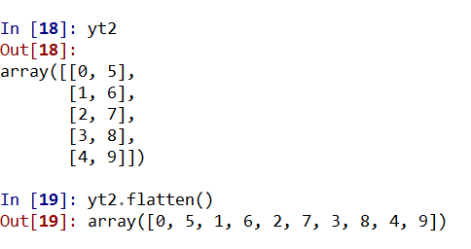
From multiple dim to one dim using flatten()

Slide 30
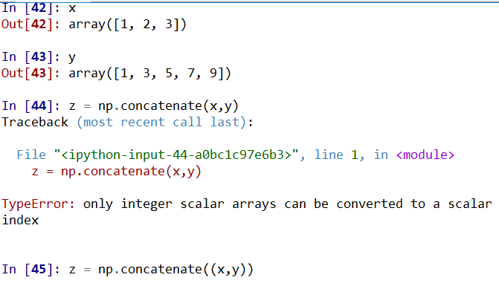
Concatenate two arrays. Note need use tuple
Note need to use iterable such as tuple

Slide 31
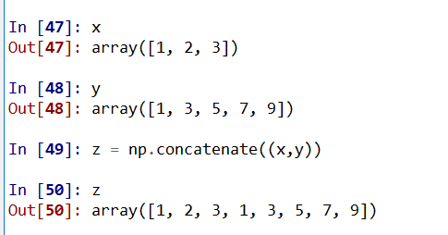
Change concatenate(x,y) to concatenate ((x,y))

Slide 32
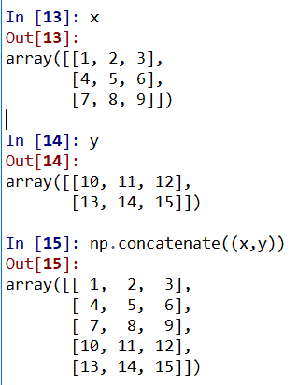
Multiple dimension concatenation
all the input array dimensions except for the concatenation axis must match exactly
Default axis is the first axis (axis=0)
The example at right
X is 3 x 3 array
Y is 2 x 3 array
So okay

Slide 33
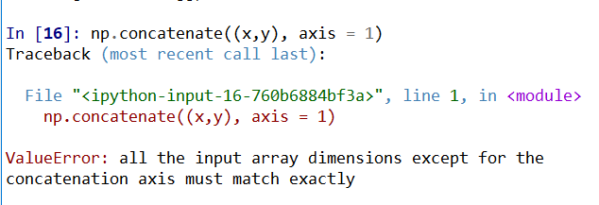
Multiple dimension concatenation(cont.)
Cannot use axis 1
Because for axis 0, x is 3 but y is 2 and not the same

Slide 34
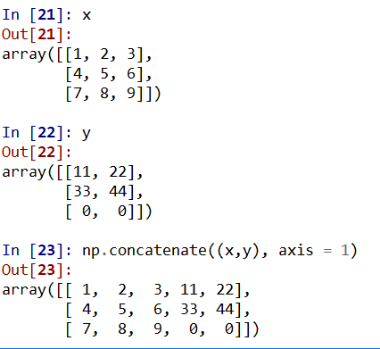
If we modify y and do it again
Change the dimension of y to be 3 x 2, note x is 3 x 3
Now we use axis 1 to concatenate. For axis 0 x is 3 and y is 3 so ok.

Slide 35
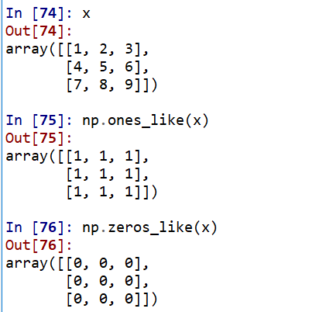
Ones_like and zeros_like

Slide 36
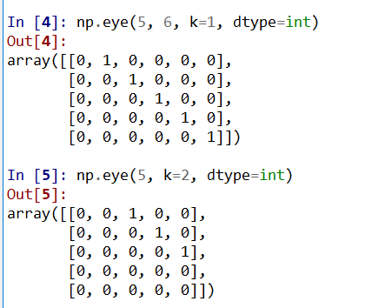
The eye function of numpy
Create a matrix with kth diagonal as 1
5 x 6 and 5 x 5 matrices

Slide 37
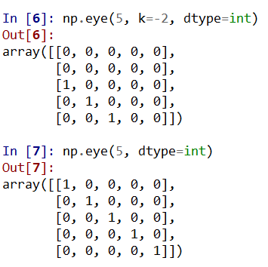
The eye function of numpy (cont.)
If no k specified then is like identity function
Note k can be negative

Slide 38
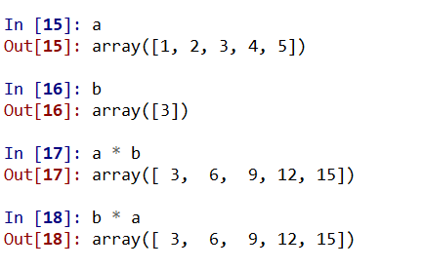
Broadcast on math operation

Slide 39
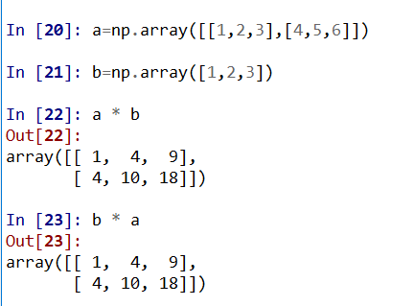
Broadcast on math operation on 2D array

Slide 40
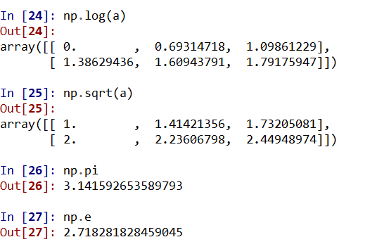
Math functions
abs, sign, sqrt, log, log10, exp, sin, cos, tan, arcsin, arccos, arctan, sinh, cosh, tanh, arcsinh, arccosh, and arctanh.

Slide 41
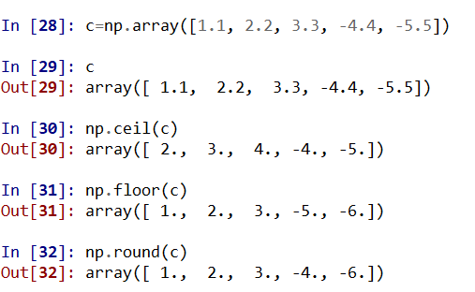
Numpy ceil, floor and round functions

Slide 42
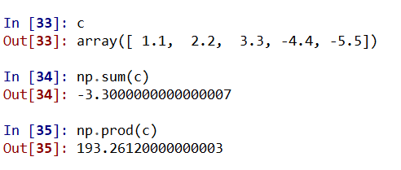
Numpy sum and prod (product)

Slide 43
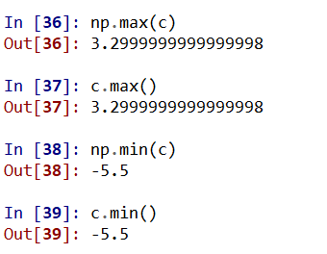
The min and max functions

Slide 44
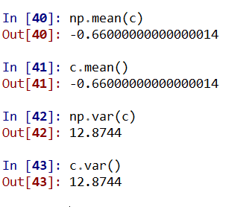
Numpy mean and variace

Slide 45
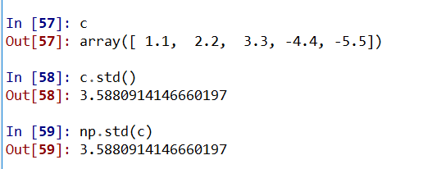
Standard deviation

Slide 46
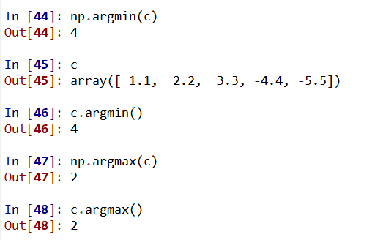
Find min and max index function:
The argmin and argmax functions return the array indices of the minimum and maximum values.

Slide 47
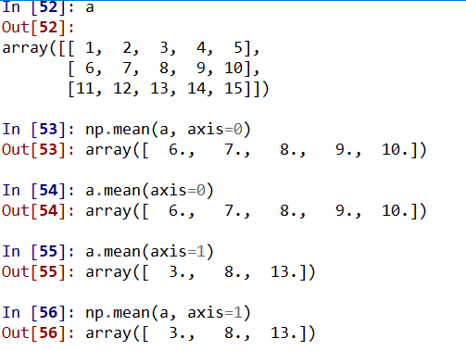
2D array statistic operations (mean)
Can specify the axis which operations will be performed
For example to get mean on axis 1, specified as axis=1

Slide 48
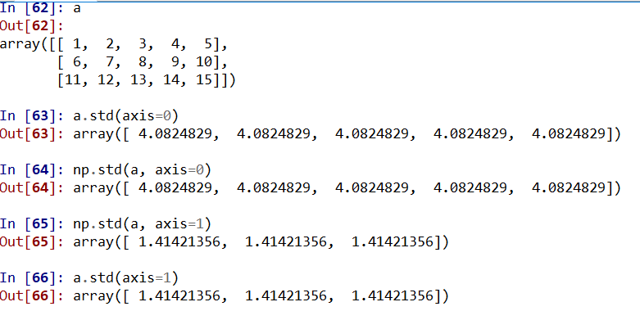
2D array statistic operations (std)

Slide 49
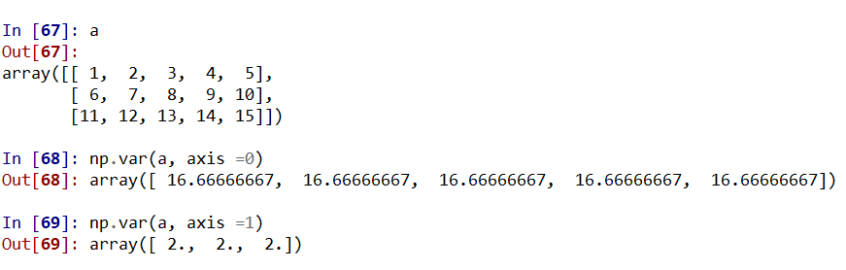
2D array statistic operations (variance)

Slide 50
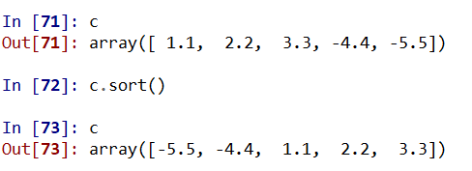
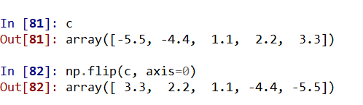
Sorting with sort() and reverse with flip (axis parm is required)

Slide 51

Numpy append method:

Slide 52

Numpy append method (cont.)

Slide 53

Numpy append method (cont.) append to second dim (axis =1)

Slide 54

unique

Slide 55

Logic operations

Slide 56

numpy.where function (condition, [x,y]) either both or neither of x and y should be given

Slide 57

Only condition is given. Return indices

Slide 58

More np.where and compare to clip(a,a_min, a_max)

Slide 59

Vector product np.dot()

Slide 60

np.dot

Slide 61

np.dot(cont.)

Slide 62

np.inner(); for vector inner is same as dot

Slide 63

The np.outer()

Slide 64

The np.outer() (cont.)

Slide 65

The np.cross(), need dim 2 or 3

Slide 66
Random numbers
Can specify a seed
Otherwise numpy will select a seed randomly (based on time)
If a seed was selected then the sequence is a pseudorandom sequence. I.e., it will always generated the same sequence when raun again.

Slide 67

Same seq if use the same seed

Slide 68

Single, multiple values, and 2d random array

Slide 69

Generate single integer random numbers can specify low and hi (exclusive)

Slide 70

Mulitple values rand ints: 1d and 2d array

Slide 71

Normal distribution: (mean, std, and size) use 0 for mean, 0.1 for std and generate 1000

Slide 72

Verify also std

Slide 73

Default is mean 0, std 1 for normal distribution. If use default and need multiple then use size

Slide 74

Use np.random.randn(d0, d1,..) to generate normal distribution numbers (mean 0, var 1)
4 rows 3 cols

Slide 75

Use Boolean array to retrieve rows

Slide 76

Use not (!=)

Slide 77

Use or (|)

Slide 78

Retrieve data according to data value

Slide 79

Use ~ to invert Boolean array to retrieve data

Slide 80

Linear algebra(numpy.linalg): determinant

Slide 81

Inverse matrix

Slide 82

The eigenvalues and eigenvectors of a matrix

Slide 83

Polynomial (coefficients and roots)
Given roots find coefficients
Given coefficients find roots

Slide 84

Polynomial integration and derivatives
Integrate x^3 + 2x^2+3x+4
Derive 1/4x^4 +2/3x^3+3/2x^2+4x

Slide 85

Evaluate a polynomial
Find value of 1/4x^4 +2/3x^3+3/2x^2+4x at x=3

Slide 86

Polyfit (x,y,degree). use least-squares method

Slide 87

High degree polyfit may oscillate

Slide 88

Check fit using polyfit

Slide 89

Check fit using polyfit

